Slide 1
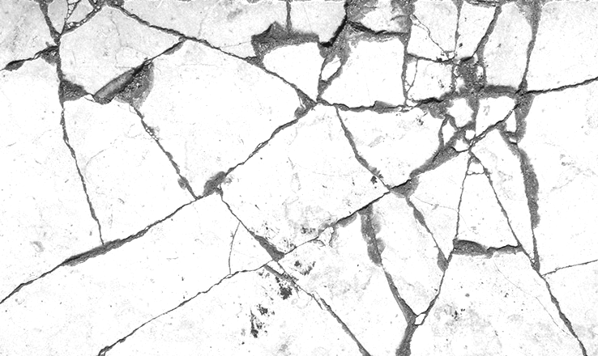
Surface Crack Detection
INFO 6105 Final Project
Changchang Li

Slide 2

Introduction
Concrete is the most important material in civil engineering.
In concrete structures, surface cracks are an important indicator for assessing the durability and serviceability of the structure.
Crack detection is important for structural health monitoring.
Notes:
undetected cracks may lead to safety risks and structural failures.

Slide 3
Procedures
Dataset Collection
Preprocessing
Model Training
Model Testing

Slide 4
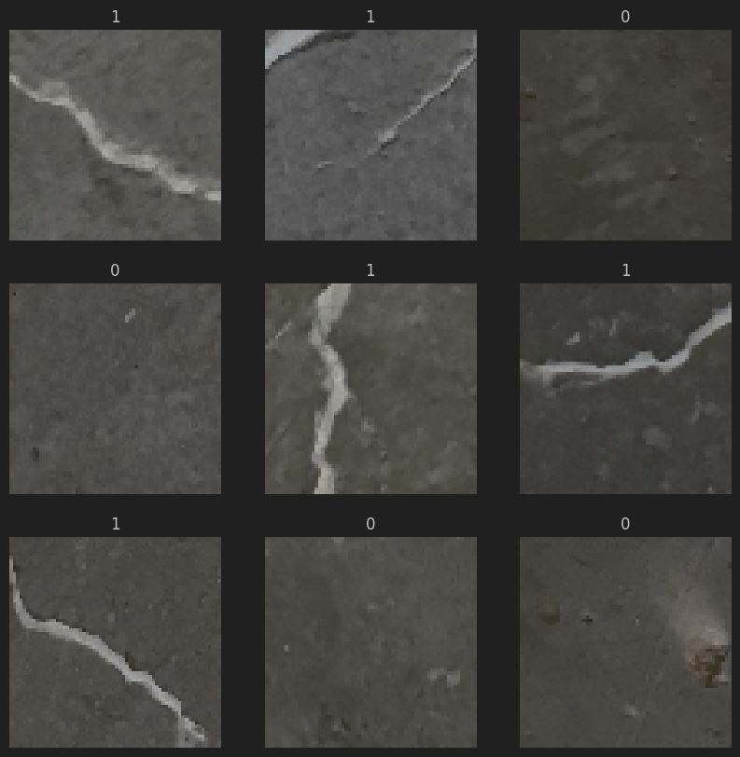
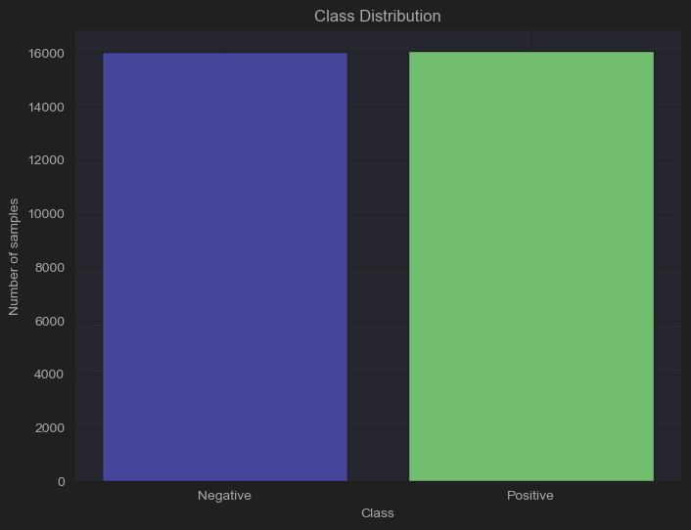
Exploratory Data Analysis
Class Balance: {'Negative': 16037, 'Positive': 16070}

Slide 5
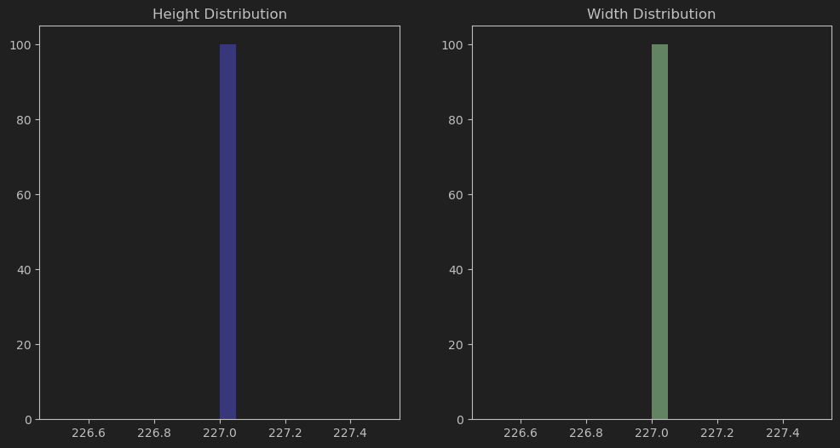
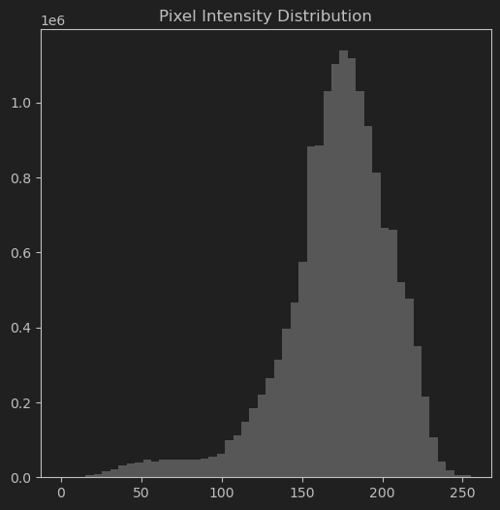
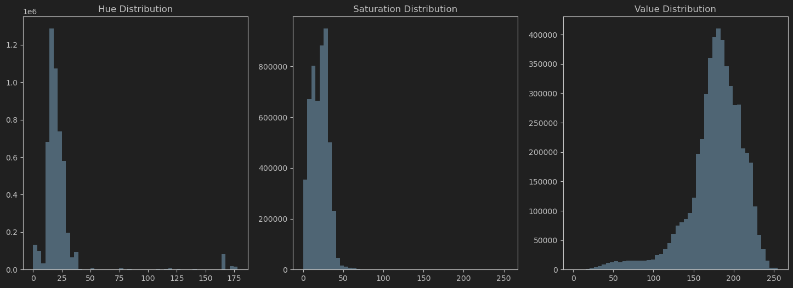
Exploratory Data Analysis
Height & Width Distribution shows that all the pictures are the same size.
Pixel Intensity Distribution shows a bell-shaped curve, indicating a generally even contrast across the dataset.
The distribution of hue, saturation, and value in the HSV color space, indicating most pixels have low hue and mid-range saturation and value, suggesting moderate color variety and balanced brightness.
Test Dataset has the same distribution.
Notes:
May lack diversity, Pixel Intensity Distribution shows each part of the image is relatively easy to distinguish without too many areas of highlights or shadows that can lead to loss of detail, HSV distribution indicates that the color variety may be relatively limited and the model may lack adaptability for images with complex or different colors

Slide 6
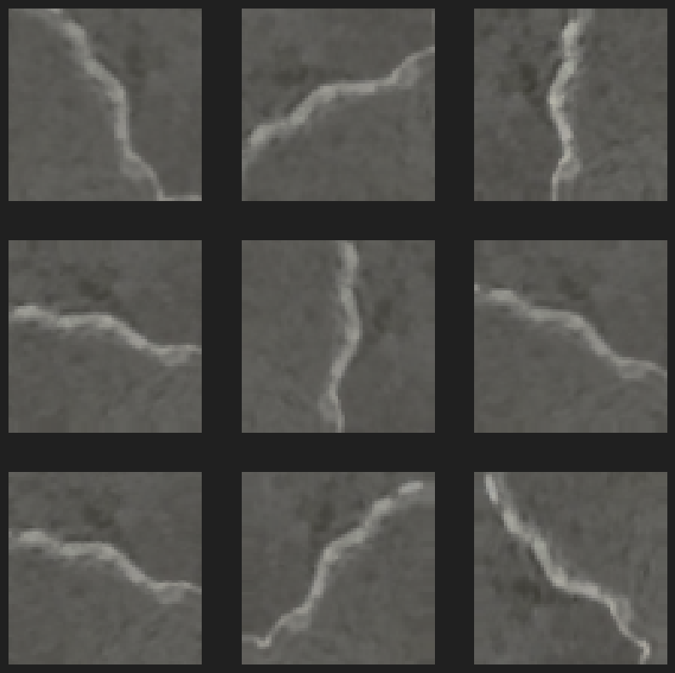
Data Preprocessing
Filter out corrupted images (none)
Resize the images to 64*64/128*128
Rescaling: Scale the range of pixel values from [0, 255] to [0, 1]
Data augmentation: help improve the generalization of models
Random Flip
Random Rotation
Random Zoom
Random Contrast

Slide 7
Model Selection
Convolutional Neural Network (CNN): 99.8%
Fully Convolutional Network (FCN)
K-Means Clustering
Logistic Regression: 80%
Feature Pyramid and Hierarchical Boosting Network (FPHBN)
Support Vector Machines (SVM)
SVM and Random Forest
SVM and Artificial Neural Network (NN)
Artificial Neural Network (ANN)
Random Structured Forests
Decision Tree: 88%
Other Deep Learning Models
The image on the right illustrates some commonly used machine learning methods for Crack Detection.
Most methods showed excellent performance outcomes as the precision values for crack detection ranged between 75% to 100%.
Among these methods, CNN has been most frequently used for this problem.
Convolutional Neural Networks (CNNs) stand out as a primary category of neural networks employed in image recognition and classification.
Notes:
The input data is provided as raw images without the specification of features to search for, and algorithm finds patterns among the image data to conduct the desired task. As the features to be used for the classification of crack presence are determined by the system, human bias/error is avoided.

Slide 8
Methods to Avoid Overfitting
Data Augmentation:
Increase the diversity of the training data
Dropout:
Help prevent neurons from co-adapting and forces them to learn robust features independently.
Regularization:
Add penalty for large weights to the loss function, simplify the model and preventing overfitting.
Batch Normalization:
Also stabilize and speed up training, normalizing the input distribution for each mini-batch.
Early Stopping:
Monitors the validation loss and stops the training process if there's no improvement
Reduce LR on Plateau:
Reduce the learning rate when the validation loss stopped improving
Notes:
Data Augmentation:
In the context of crack detection, data augmentation can significantly improve the model's ability to generalize from the training data to new, unseen images. For instance, by introducing random rotations and flips, the model can learn to recognize cracks regardless of their orientation in the image. Random zooms can help the model learn to detect cracks of various sizes, and random changes in brightness or contrast can teach the model to recognize cracks under different lighting conditions.
Dropout:
Dropout is a regularization technique that randomly "drops out" (sets to zero) a number of output features of the layer during training. For crack detection, this means that during each training pass, a random subset of neurons is ignored. This forces the network to learn more robust features that are useful in conjunction with many different random subsets of the other neurons. It helps to prevent overfitting by ensuring that the network does not rely on any one feature too heavily and thus can perform well when detecting cracks in new images that may not be represented in the training set.
Regularization:
Regularization techniques such as L1 and L2 add a penalty for large weights to the loss function. In a crack detection system, regularization ensures that the model weights stay small, which makes the model simpler and less prone to overfitting. This is particularly useful for crack detection where the distinction between cracks and other small surface features can be subtle, and a less complex model may generalize better to new images.
Batch Normalization:
Batch Normalization normalizes the input of a layer by adjusting and scaling the activations. For crack detection, this means that each batch of images has its distribution of pixel values standardized, which helps to stabilize the learning process and significantly speeds up the training of CNNs. It allows each layer of the network to learn on a more consistent set of data, reducing the number of epochs required to train deep networks effectively.
Early Stopping:
Early Stopping is a form of regularization used to avoid overfitting when training a learner with an iterative method, such as gradient descent. In the case of crack detection, early stopping monitors the model's performance on a validation set and stops the training process if the performance on the validation set does not improve for a specified number of epochs. This ensures that the model does not overfit the training data by terminating the process before it learns to recognize noise as a feature.
Reduce Learning Rate on Plateau:
This technique involves reducing the learning rate when a metric stops improving. For crack detection models, this method allows the model to fine-tune the weights when it appears to have reached a plateau in the learning curve. A smaller learning rate can help the model to make smaller adjustments to the weights, which can lead to better performance and more precise crack detection on the validation set.
By employing these techniques, a deep learning model for crack detection becomes more robust and generalizes better to new, unseen data, ultimately resulting in improved performance on the actual task of detecting cracks in various structures.

Slide 9
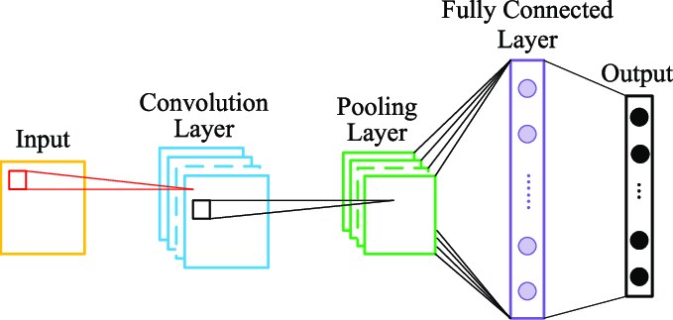
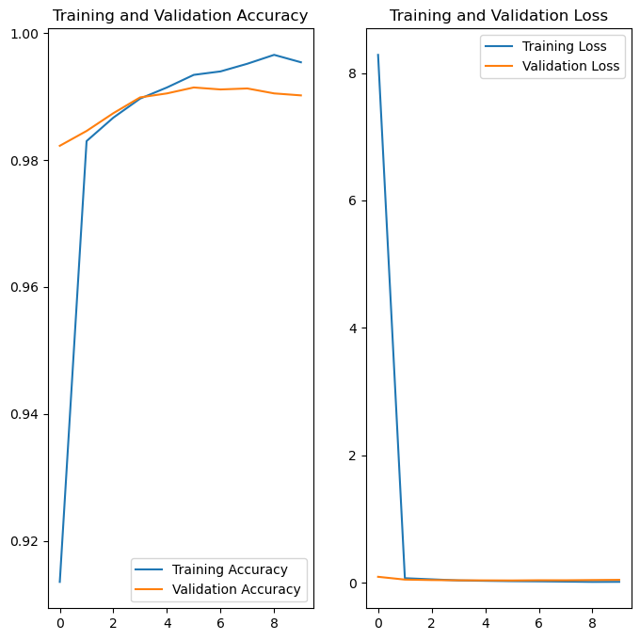
Model Training
I utilize a straightforward CNN model featuring an input size of 64x64x3, with a batch size set at 128 and the training conducted over 10 epochs:
model0 = Sequential([ Input(shape=(64, 64, 3)), layers.Conv2D(16, 3, padding='same', activation='relu'), layers.MaxPooling2D(), layers.Flatten(), layers.Dense(64, activation='relu'), layers.Dense(1, activation='sigmoid') ])
Training time: 1min 9s 668ms
Cross validation accuracy: 99.4550%
Notes:
The information suggests that model0 is a lightweight and fast-training CNN that performs well on the given task, achieving high accuracy in cross-validation, indicating good generalization on unseen data.

Slide 10
Model Training
Convolution Layers | Pooling Layers | Fully Connected Layers (units) | Batch Size | Epochs | Batch Normalization | Dropout | Data Augmentation | Early Stopping | Run Time for Training | Validation Accuracy
1 | 1 | 64 | 128 | 5 |  |  |  |  | 18s 270ms | 0.9829
1 | 1 | 64 | 64 | 5 |  |  |  |  | 52s 15ms | 0.9871
1 | 1 | 64 | 128 | 10 |  |  |  |  | 1m 9s 668ms | 0.9905
1 | 1 | 64 | 128 | 5 |  |  | Rescale, flip, rotate, zoom 0.1 |  | 59s 756ms | 0.9727
3 | 3 | 128 | 128 | 10 |  |  |  |  | 1m 1s 684ms | 0.9988
3 | 3 | 128 | 128 | 10 |  |  | Rescale, flip, rotate, zoom 0.1 |  | 4m 5s 325ms | 0.9938
3 | 3 | 128 | 128 | 15 | Y | 0.3, 0.3 | Rescale, flip, rotate, zoom 0.1 |  | 8m 37s 26ms | 0.9960
3 | 3 | 128 | 128 | 25 | Y | 0.3, 0.3 | Rescale, flip, rotate, zoom 0.1 | Stopped at 15 | 8m 13s 578ms | 0.9967
3 | 3 | 128 | 128 | 25 | Y | 0.3, 0.3 | Rescale, flip, rotate, zoom 0.2 | Stopped at 10 | 5m 32s 454ms | 0.9974
5 | 5 | 256, 128 | 128 | 30 | Y | 0.3, 0.3, 0.3 | Rescale, flip, rotate, zoom 0.2 | Stopped at 15 | 10m 16s 668ms | 0.9983
5 | 5 | 256, 128 | 128 | 30 | Y | 0.3, 0.3, 0.3 | Rescale, flip, rotate 0.2, zoom 0.1 | Stopped at 9 | 6m 1s 652ms | 0.9975
Notes:
Doesn't present all the attempts, just want to Control variables.
I have experienced quite a few system crashes, memory errors, and GPU anomalies. I understand that hardware can have a significant impact on the speed of model training. Although I try to ensure that these training time records are under the same hardware conditions, there might still be an impact.

Slide 11
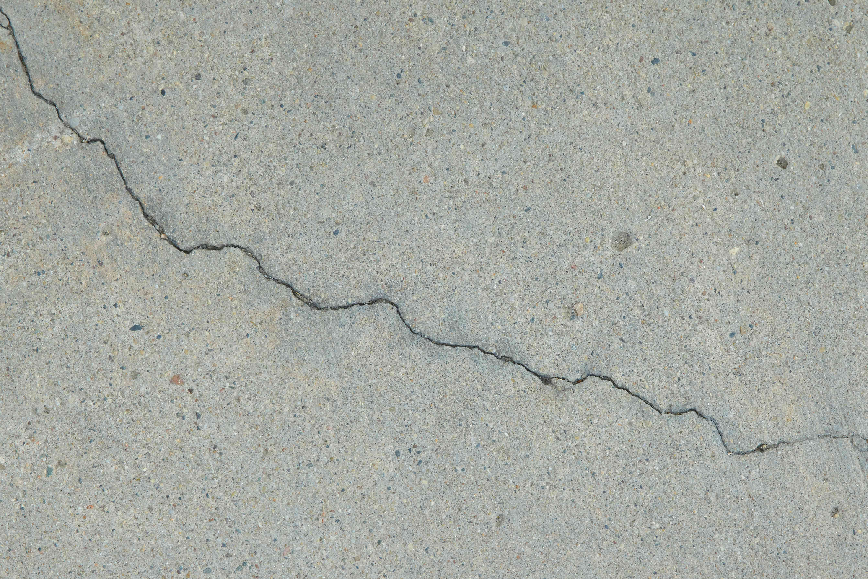
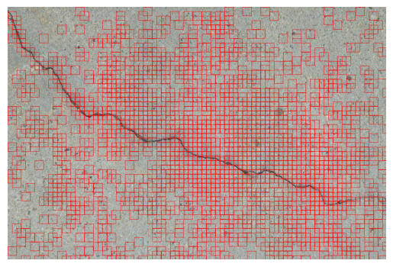
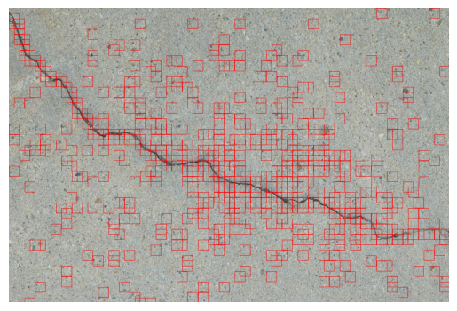
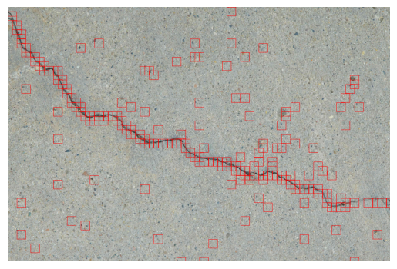
What If We Test an Image Not Belong to the Given Dataset?
3 conv. layers with dropout and batch normalization
3 conv. layers with dropout, batch normalization, data augmentation
5 conv. layers with dropout, batch normalization, data augmentation

Slide 12
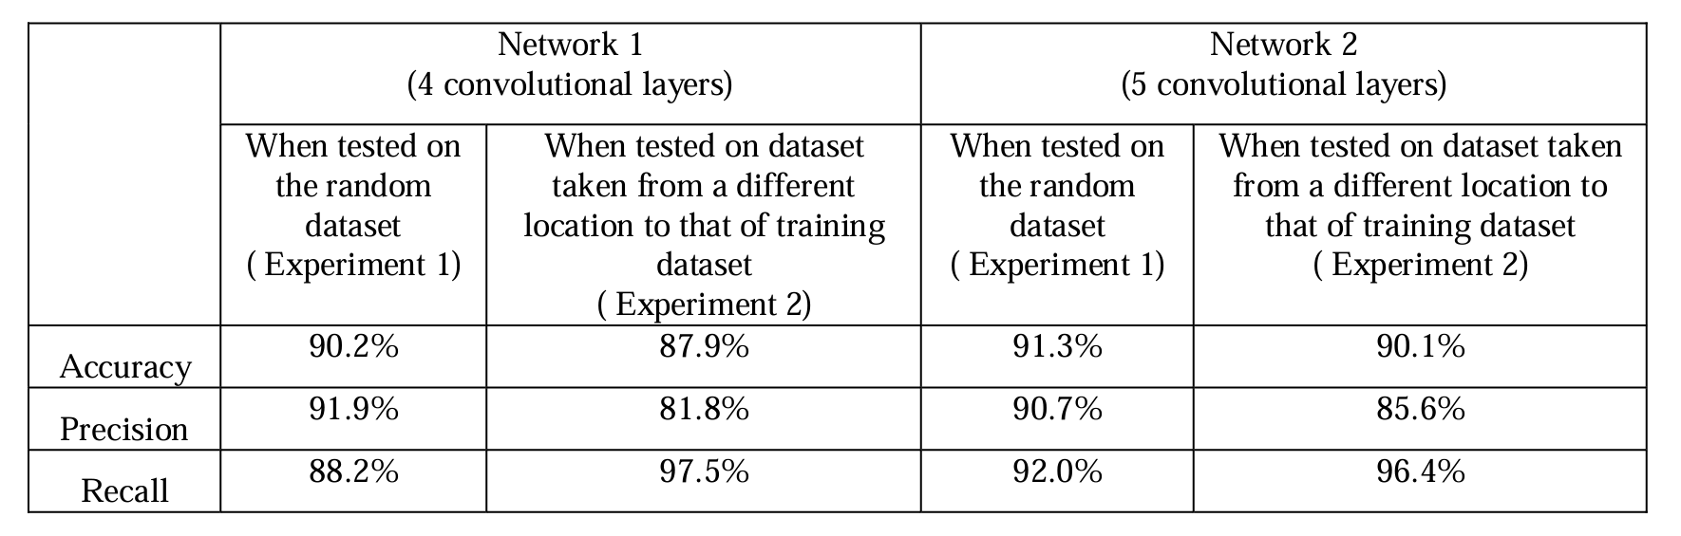
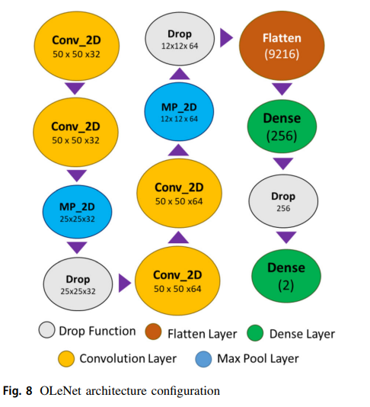
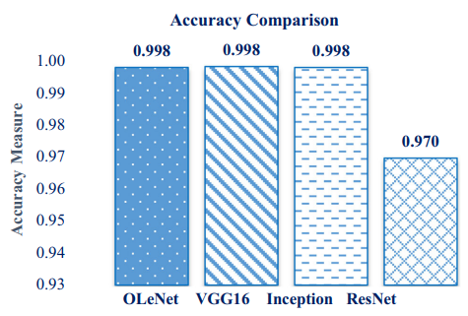
Model Training
Deeper neural networks improve accuracy, and location affects results.
Optimizing the hyperparameters in the CNN architecture achieves higher accuracy even with fewer layers to enhance computational performance.
Notes:
The study finds that deeper neural networks improve crack detection accuracy. Performance drops when training and testing images come from different locations, indicating that location affects results.

Slide 13
Use Tuner to Get Best Hyperparameters
Model: "sequential"
_________________________________________________________________
Layer (type) Output Shape Param #
=================================================================
conv2d (Conv2D) (None, 128, 128, 112) 3,136
batch_normalization (BatchNormaliz. (None, 128, 128, 112) 448
max_pooling2d (MaxPooling2D) (None, 64, 64, 112) 0
conv2d_1 (Conv2D) (None, 64, 64, 144) 145,296
batch_normalization_1 (BatchNormal. (None, 64, 64, 144) 576
max_pooling2d_1 (MaxPooling2D) (None, 32, 32, 144) 0
conv2d_2 (Conv2D) (None, 32, 32, 192) 249,024
batch_normalization_2 (BatchNormal. (None, 32, 32, 192) 768
max_pooling2d_2 (MaxPooling2D) (None, 16, 16, 192) 0
conv2d_3 (Conv2D) (None, 16, 16, 240) 414,960
batch_normalization_3 (BatchNormal. (None, 16, 16, 240) 960
max_pooling2d_3 (MaxPooling2D) (None, 8, 8, 240) 0
conv2d_4 (Conv2D) (None, 8, 8, 32) 69,152
batch_normalization_4 (BatchNormal. (None, 8, 8, 32) 128
max_pooling2d_4 (MaxPooling2D) (None, 4, 4, 32) 0
dropout (Dropout) (None, 4, 4, 32) 0
flatten (Flatten) (None, 512) 0
dense (Dense) (None, 128) 65,664
dropout_1 (Dropout) (None, 128) 0
dense_1 (Dense) (None, 1) 129
=================================================================
Total params: 950,241
Trainable params: 948,801
Non-trainable params: 1,440
_________________________________________________________________
Best validation accuracy: 0.9990655779838562
Total elapsed time: 2d 03h 23m 54s
Best hyperparameters:
num_conv_layers: 5 3-5
filters_0: 112 16-256
filters_1: 144 16-256
filters_2: 192 16-256
dropout_1: 0.2 0.2-0.5
dense_units: 128 18-512
regularizer_l2: 0.0001 [0.01, 0.001, 0.0001]
dropout_2: 0.300 0.2-0.5
learning_rate: 0.01 [1e-2, 1e-3, 1e-4]
filters_3: 240 16-256
filters_4: 32 16-256
Cost a lot of resources and time

Slide 14
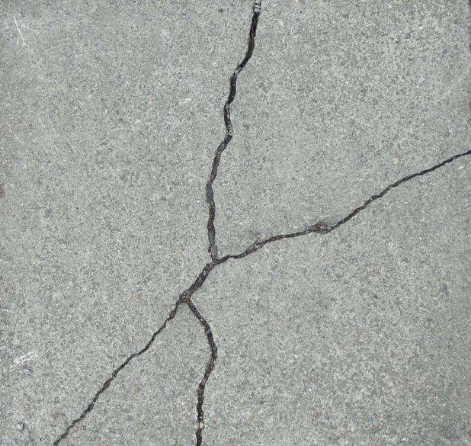
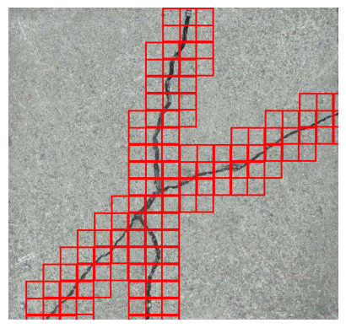
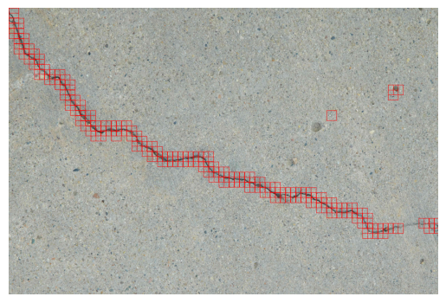
Samples
Notes:
Using deeper networks could improve the accuracy of crack detection

Slide 15
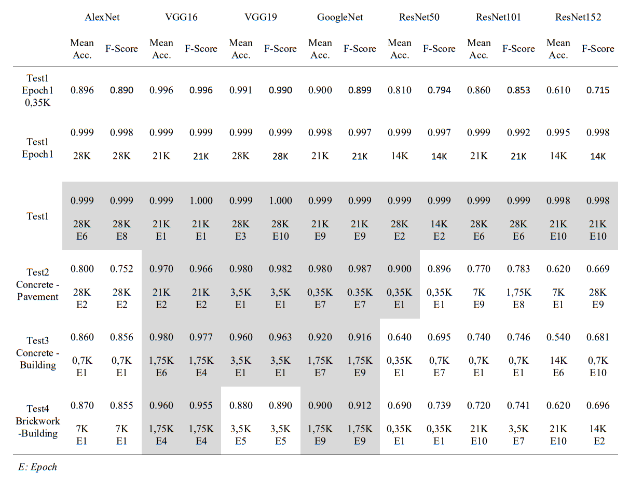
Pretrained Models
Availability of the pretrained networks eases the applicability of CNN’s in new tasks without the requirement of high computational cost and deep knowledge on how CNN’s operate.
Pretrained CNNs can be effectively used for crack detection in building structures with high accuracy, especially when fine-tuned with transfer learning.
They can recognize and classify crack features across different materials and under varied environmental conditions.

Slide 16
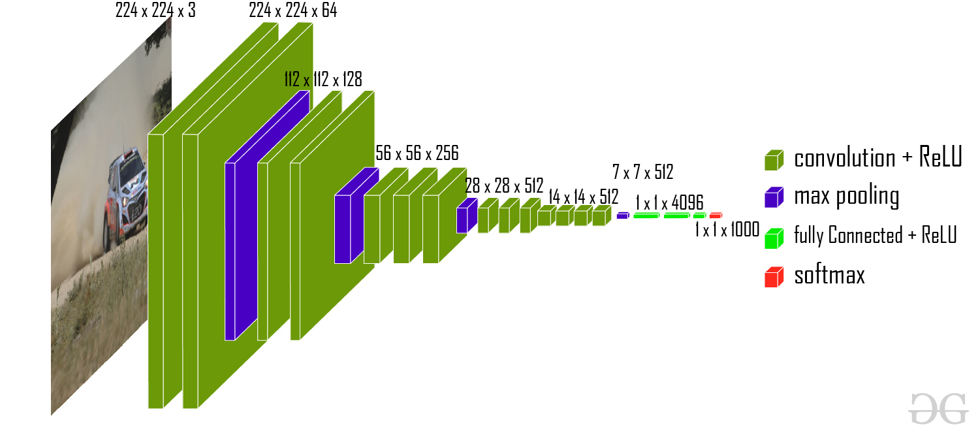
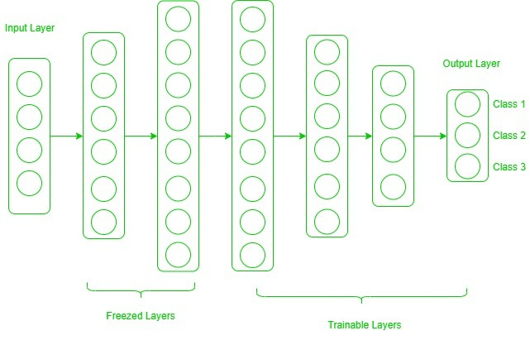
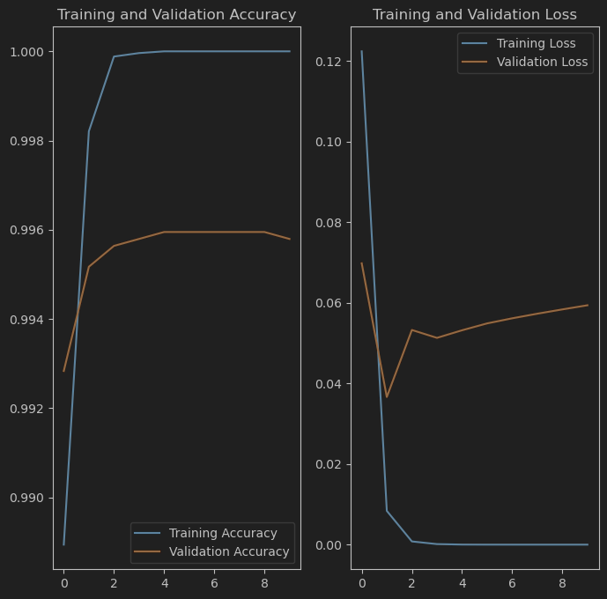
Transfer Learning Using Pretrained Model - VGG16
VGG-16 architecture, VGG-16 | CNN model - GeeksforGeeks
Transfer learning is a technique in machine learning where a model trained on one task is used as the starting point for a model on a second task.
By using pretrained model, the model can learn more quickly and effectively on new tasks.
Epoch 1: val_loss: 0.0698 - val_accuracy: 0.9928
10 epochs training time: 13min 58s 209ms (image size 224*224)

Slide 17
Learning and Conclusion
Learning:
The project has demonstrated that CNNs can effectively detect cracks in concrete.
Conclusion:
The CNNs have proven highly accurate in detecting surface cracks.
We have observed that strategic techniques combating overfitting, allowing our model to maintain high performance; they are practical tools in e without being misled by noise in the data.
Experimenting with different CNN structures and tuning hyperparameters has been key to model accuracy.
Future directions include enhancing model robustness with more varied data and to develop faster models for real-time use.
Ongoing updates and testing will ensure our model adapts to different conditions for practical use.
Notes:
We aim to train with a wider range of materials and lighting to make the model more universally applicable.

Slide 18
Thank you!

Slide 19
Reference
Özgenel, Ç. F., & Sorguç, A. G. (2018). Performance Comparison of Pretrained Convolutional Neural Networks on Crack Detection in Buildings. In Proceedings of the 35th International Symposium on Automation and Robotics in Construction (ISARC 2018), Berlin, Germany: ISBN 978-3-00-060855-1, ISSN 2413-5844. https://doi.org/10.22260/ISARC2018/0094
Ye, G., Dai, W., Tao, J., et al. (2024). An improved transformer-based concrete crack classification method. Scientific Reports, 14(6226). https://doi.org/10.1038/s41598-024-54835-x
Pauly, L., Peel, H., Luo, S., Hogg, D., & Fuentes, R. (2017). Deeper Networks for Pavement Crack Detection. In Proceedings of the 34th International Symposium on Automation and Robotics in Construction (ISARC) (pp. 479-485). Taipei, Taiwan: ISBN 978-80-263-1371-7, ISSN 2413-5844. https://doi.org/10.22260/ISARC2017/0066
Mazni, M., Husain, A. R., Shapiai, M. I., Ibrahim, I. S., Anggara, D. W., & Zulkifli, R. (2024). An investigation into real-time surface crack classification and measurement for structural health monitoring using transfer learning convolutional neural networks and Otsu method. Alexandria Engineering Journal, 92, 310-320. https://doi.org/10.1016/j.aej.2024.02.052
Munawar, H. S., Hammad, A. W. A., Haddad, A., Soares, C. A. P., & Waller, S. T. (2021). Image-Based Crack Detection Methods: A Review. Infrastructures, 6(8), 115. https://doi.org/10.3390/infrastructures6080115
Zhang, Q., Zhao, X., & Hu, Y. (2020). A Classification Retrieval Method for Encrypted Speech Based on Deep Neural Network and Deep Hashing. IEEE Access, 8, 202469-202482. https://doi.org/10.1109/ACCESS.2020.3036048
Kim, B., Yuvaraj, N., Sri Preethaa, K.R. et al. Surface crack detection using deep learning with shallow CNN architecture for enhanced computation. Neural Comput & Applic 33, 9289–9305 (2021). https://doi.org/10.1007/s00521-021-05690-8
https://www.tensorflow.org/tutorials?hl=en
https://keras.io/guides/
https://www.geeksforgeeks.org/ml-introduction-to-transfer-learning/

Slide 20
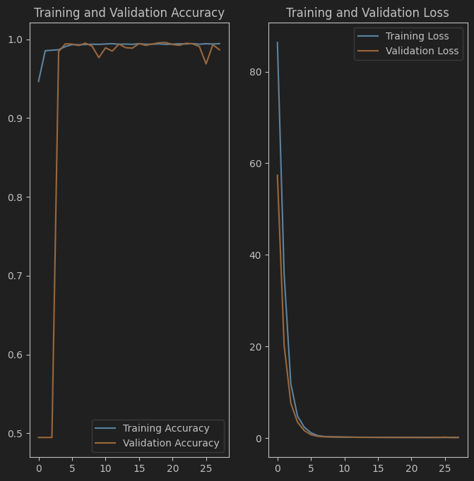
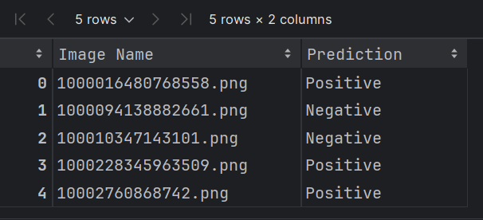
Training and Validation Accuracy and Loss
Make prediction:

